Slide 1
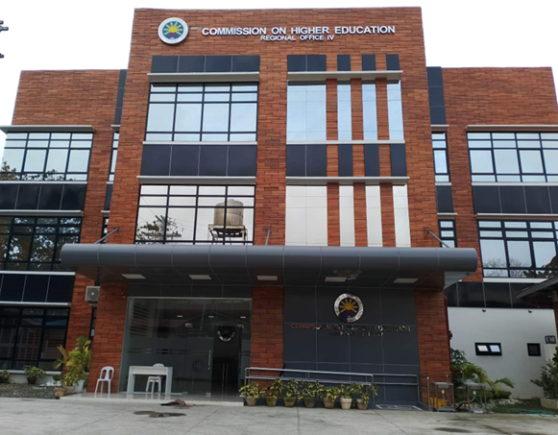
Staying Ahead:
Key CHED Policy Updates and Their Impact on Higher Education
Dr. Freddie B. Bulauan
OIC, Office of the Director IV
CHED Regional Office IV

Slide 2

Quality Assurance and Accreditation
CHED’s commitment to rigorous quality assurance ensures that Philippine higher education is not just compliant but exemplary
Outcomes-Based Education
CHED's Outcomes-Based Education (OBE) Framework mandates HEIs to design their curricula around specific student outcomes, such as critical thinking and ethical responsibility.
Faculty Qualifications
CHED emphasizes the importance of qualified faculty, ensuring that educators possess the necessary expertise and skills to guide students effectively.
Resource Adequacy
CHED ensures that HEIs have sufficient resources, including infrastructure, technology, and financial support, to provide a high-quality learning environment.

Slide 3

Internationalization of Higher Education
Partnerships
Global Perspectives
Innovation
CHED encourages HEIs to establish partnerships with foreign institutions, offering dual degree programs and academic exchange initiatives.
Internationalization helps students and faculty gain international exposure, enhancing their global perspectives and employability.
International partnerships bring the world's best practices to the Philippines and project Philippine excellence to the world.

Slide 4
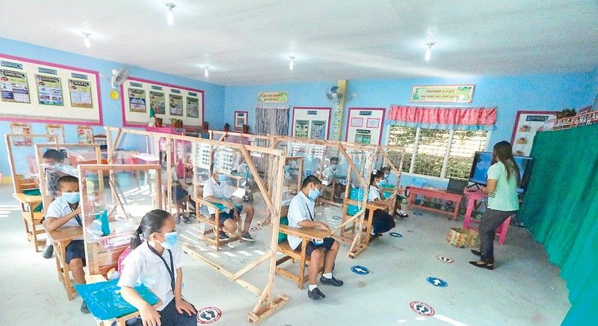

Flexible Learning and Digital Transformation
1
Online Learning
2
Digital Infrastructure
3
Digital Rise Program
CHED supports the adoption of online, blended, and hybrid learning modalities, making education more accessible and adaptable.
CHED invests in developing digital infrastructure and training faculty in digital pedagogy to enhance student learning experiences.
CHED's Digital Rise Program provides funding and support for universities to establish digital learning platforms.

Slide 5





Research and Innovation
National and Regional
Priorities
Grants and Incentives
Knowledge Generation
CHED offers grants and incentives for innovative research projects, fostering a research culture within institutions through IDIG.
Research contributes to the country's development through knowledge generation and technology transfer.
CHED encourages HEIs to engage in research that addresses national and regional priorities.

Slide 6
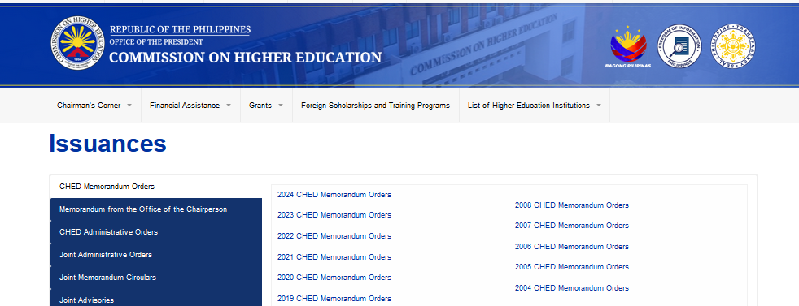
Governance and Regulatory Compliance
Streamlined Processes
Reduced Bureaucratic Barriers
National Education Standards
International Education Standards

Slide 7




Challenges and Opportunities
Resource Needs
Challenges include the need for resources, faculty training, and infrastructure development.
Innovation
Opportunities include the chance for HEIs to innovate, improve student outcomes, and strengthen their institutional reputation.
Community Engagement
Challenges can be turned into opportunities for community engagement and development.

Slide 8
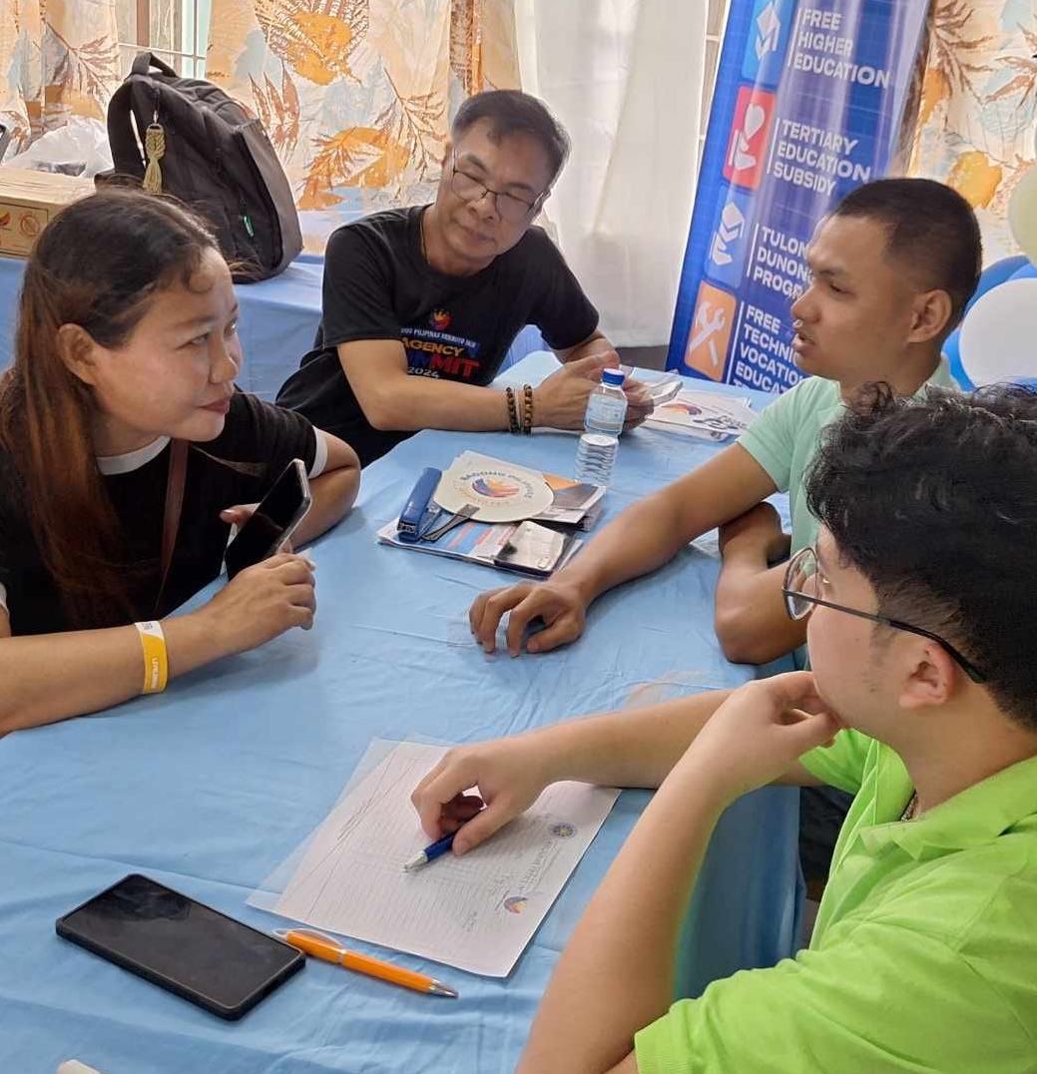
Role of Higher Education Stakeholders
1
Collaboration
Active collaboration among HEIs, government agencies, industry partners, and civil society is crucial for successful implementation of CHED policies.
2
Best Practices
Stakeholders need to work together to address challenges, share best practices, and contribute to the continuous improvement of the education system.
3
Transformative Impact
Collaboration can turn policy aspirations into real-world impacts that transform lives and communities.

Slide 9




How to stay updated with CHED?
Remain competitive and effective
By proactively engaging with these policies, institutions can better navigate challenges and seize opportunities for growth and innovation
Be dynamic
To remain static is to fall behind. The future of education is unfolding now—are we ready to shape it?
Constant Change
The landscape of higher education is rapidly evolving due to several transformative trends and challenges. Globalization, technological advancements, and shifting societal needs are reshaping how education is delivered, accessed, and valued

Slide 10

Key Factors Shaping Higher Education
The landscape of higher education is evolving rapidly. Technological advancements, globalization, and changing workforce demands are driving significant transformations. Institutions must adapt to remain relevant and effective.

Slide 11

Technological Integration
1
Digital Transformation
Rise of digital technologies and online platforms transforming traditional teaching models.
2
Flexible Learning
Enabling remote and flexible options to cater to diverse student needs.
3
Pandemic Acceleration
COVID-19 prompting rapid adoption of hybrid and blended learning modalities.

Slide 12
Globalization and Internationalization
Global Education
Skill Focus
Curriculum Alignment
Increased international exchanges, partnerships, and research collaborations enhancing education quality.
Emphasis on critical thinking, creativity, and adaptability to meet evolving industry needs.
Adapting curricula to align with demands of a dynamic, interconnected global economy.

Slide 13

Changing Workforce Demands
As industries evolve, there is a growing emphasis on equipping graduates with skills beyond academic knowledge, such as critical thinking, creativity, and adaptability. This shift calls for curricula that are more aligned with the demands of a dynamic and interconnected global economy.

Slide 14

Focus on Research, Innovation
Societal Progress
Stronger push for institutions to contribute through research and innovation.
Key Focus Areas
Addressing sustainability, health, and technology issues through research.
Quality Standards
Refining accreditation and quality assurance mechanisms for accountability.

Slide 15


